Slide 1
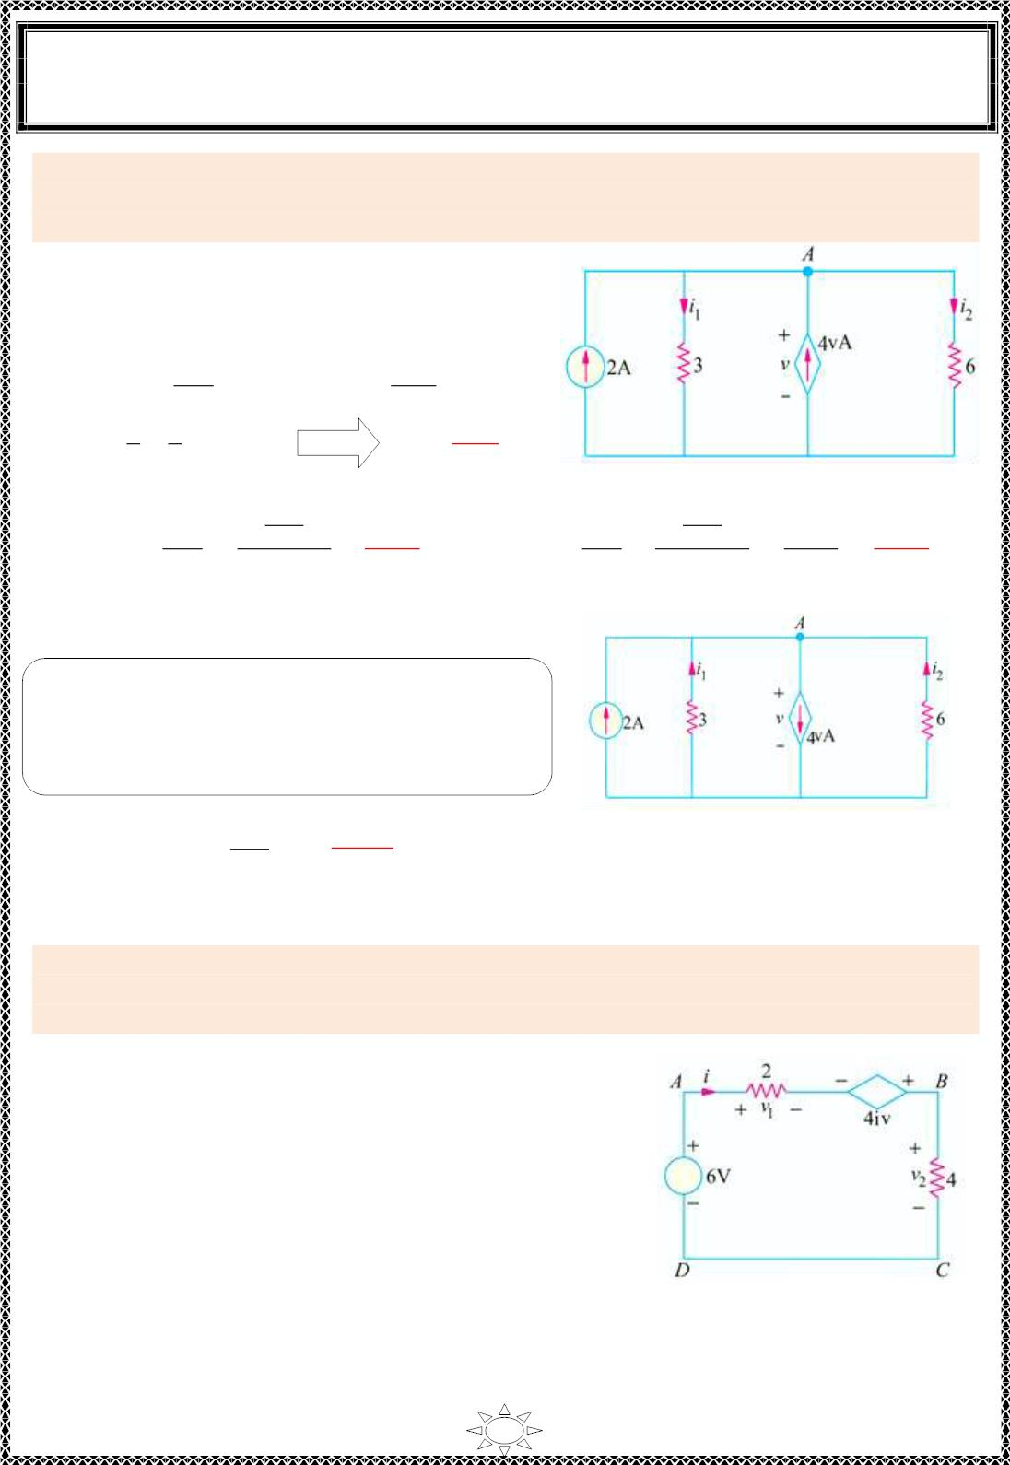
University of Diyala
Engineering College
Electronic Department
Electrical Engineering Fundamentals
1st Class
Asst., Lecturer : Wisam N. AL-Obaidi
Year (2013-2014)
Example 10: By applying Kirchhoff‘s current la w, obtain the values of v, i and i in the
1
2
circuit of Figure (3.17) which contains a voltage-dependent current source. Resistance
values are in ohms.
Solution:
Applying KCL to node A of the c irc uit, we get
2 − i + 4v −i = 0
or
1
2
i + i − 4v = 2
1
2
Now,
i₁ =
v
3
and
i₂ =
v
6
∴
∴
v
3
v
−ퟒ
ퟕ
+ − 4v = 2
v =
V
6
Figure (3.17)
−4
ꢀ
−4
i₁ =
v
3
=
7
3
=
−ퟒ
A & i₂ =
v
6
=
ꢀ
−4
7
−ퟐ
ퟐퟏ
6
=
42
=
ퟐퟏ
A
Trail Version
Trail Version
Trail Version
Trail Version
Trail Version
Trail Version
Trail Version
Trail Version
Trail Version
Trail Version
Trail Version
Trail Version
Trail Version
Note:- as the currents s ign are negative then the
actual direct ion of these currents are opposite to
the dir ection ind icated previously as shown in
Figure (3 .18).
&
4v = 4 × ⁻⁴ ꢀ =
−ퟏퟔ
V
Figure (3.18)
7
ퟕ
Example 11: Apply Kirchhoff‘s voltage la w, to find the values of current i and the voltage
drops v and v in the circuit of Figure (3.19) whic h contains a current-dependent vo ltage
1
2
s ource. What is the voltage of the dependent source ? All resistance values are in ohms.
Solution:
Applying KVL to the circuit of Figure (3.19) and starting
from point A, we get
−v + 4i −v + 6 = 0 or v − 4i + v = 6
Now,
∴
∴
1
2
1
2
v = 2i and v = 4i
1 2
2i − 4i + 4i = 6 or i = 3A
v₁ = 2 × 3 = 6V
and
v₂ = 4 × 3 = 12 V
Voltage of the dependent source = 4i = 4 × 4 = 12 V
Figure (3.19)
51

Slide 2
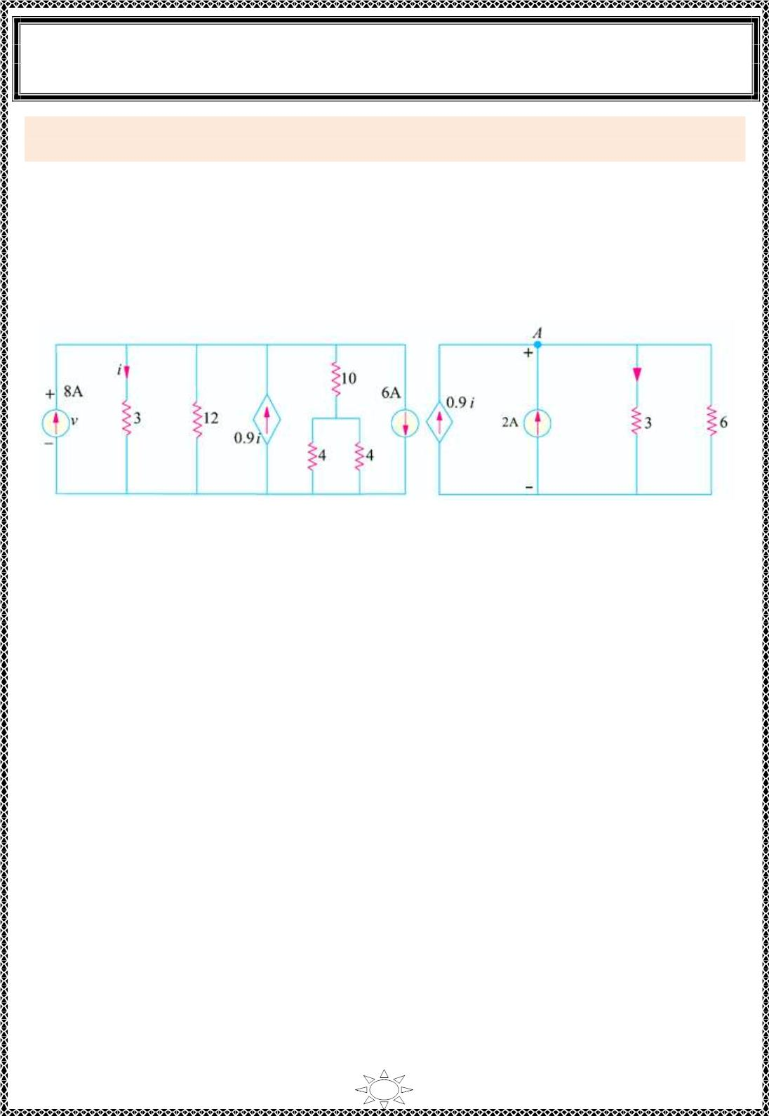
University of Diyala
Engineering College
Electronic Department
Electrical Engineering Fundamentals
1st Class
Asst., Lecturer : Wisam N. AL-Obaidi
Year (2013-2014)
Example 12: Find the current i and also the power and voltage of the dependent source in
Figure (3 .20 ). All res istances are in ohms.
Solution:
The two current s ources can be combined in to a s ing le source of (8 − 6 = 2 A). The two
parallel 4 Ω resistances when combined have a value of (2 Ω) which, being in series wit h
the 10 Ω resistance, gives the branch resistance of (10 + 2 = 12 Ω). This 12 Ω resistance
when combined with the other 12 Ω res istance gives a combinat ion res istance of (6 Ω).
The s imp lif ied circuit is shown in Figure (3.21 ).
Trail Version
Trail Version
Trail Version
Trail Version
Trail Version
Trail Version
Trail Version
Trail Version
Trail Version
Trail Version
Trail Version
Trail Version
Trail Version
Figure (3.20 )
Figure (3.21)
Applying KCL to node A, we get
0.9i + 2 −i − V/6 = 0
Also v = 3i
or
∴
0.6i = 12 − v
i = 10/3 A.
Hence, v = 10 V.
The power furnished by the current source = v × 0.9 i = 10 × 0.9 (10/3) = 30 W.
52

Slide 3
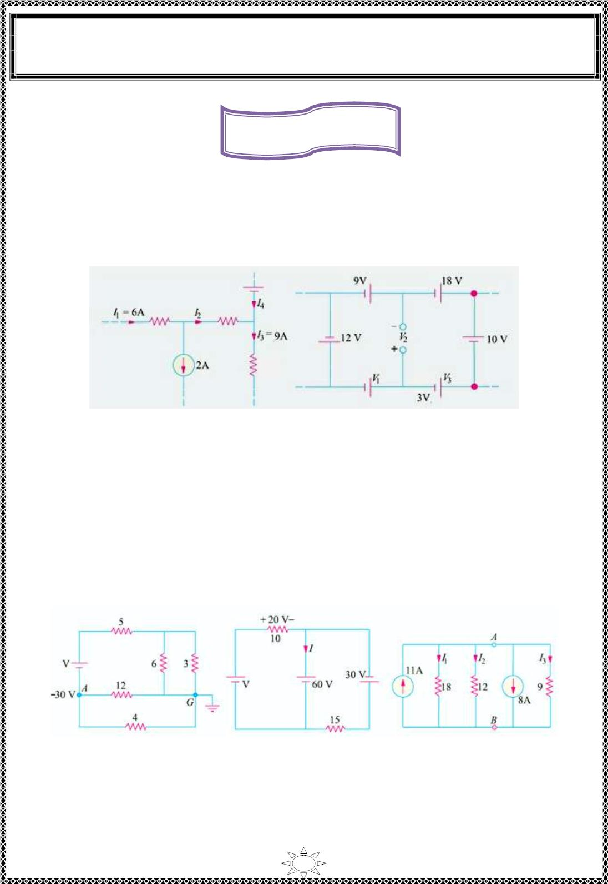
University of Diyala
Engineering College
Electronic Department
Electrical Engineering Fundamentals
1st Class
Asst., Lecturer : Wisam N. AL-Obaidi
Year (2013-2014)
Home Works
H.W.(1):- Find the values of currents I and I in the network of Figure (3.22 ).
2
4
[ Answer: I = 4 A ; I = 5 A]
2
4
H.W.(2):- Use Kirchhoff‘s la w, to f ind the values of voltages V and V in the network
shown in Figure (3.23).
1
2
[Answer: V = 2 V ; V = 5 V]
1 2
Trail Version
Trail Version
Trail Version
Trail Version
Trail Version
Trail Version
Trail Version
Trail Version
Trail Version
Trail Version
Trail Version
Trail Version
Trail Version
Figure (3.22)
Figure (3.23 )
H.W.(3):- In Figure (3.24), the potential of point A is − 30 V. Us ing Kirchhoff‘s voltage
la w, find (a) value of V and (b) power dis s ipated by 5 Ω res istance. All res istances are in
ohms.
[1 00 V; 500 W]
H.W.(4):- Us ing KVL and KCL, find the values of V and I in Figure (3.25). All
resistances are in ohms. [80 V; − 4 A]
H.W.(5):- Us ing KCL, f ind the values V , I , I and I in the circuit of Figure (3.26). All
resistances are in ohms.
AB
1
2
3
[V = 12 V ; I = 2/3 A; I = 1 A; I = 4/3 A]
AB
1
2
3
Figure (3.24 )
Figure (3.25)
Figure (3.26 )
53

Slide 4
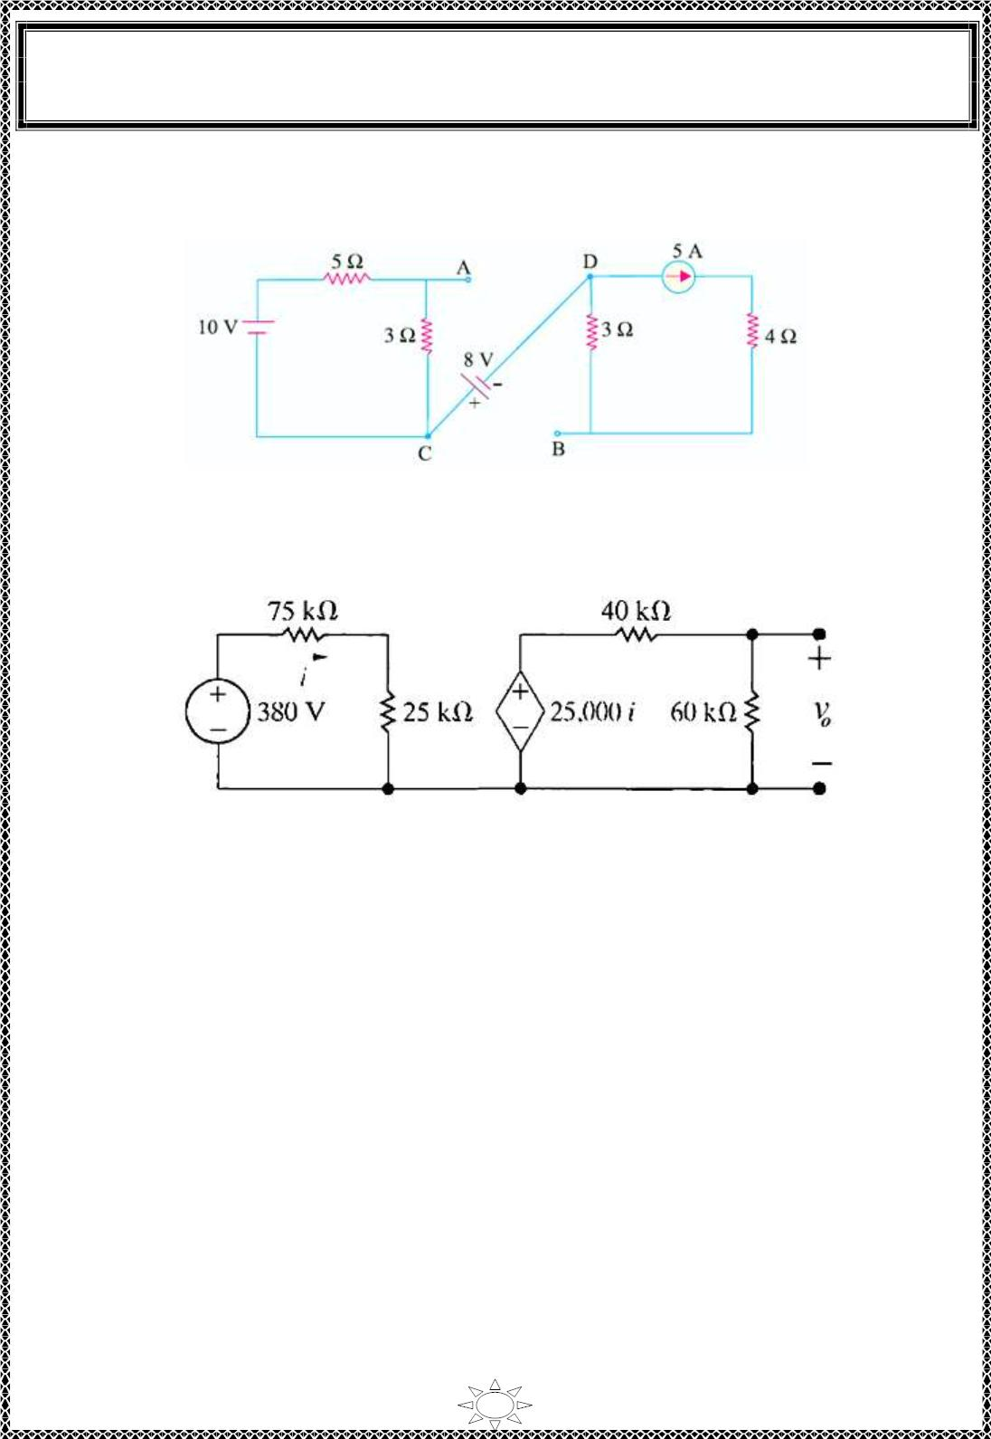
University of Diyala
Engineering College
Electronic Department
Electrical Engineering Fundamentals
1st Class
Asst., Lecturer : Wisam N. AL-Obaidi
Year (2013-2014)
H.W.(6):- F ind the vo ltage of point A with respect to point B in the Figure (3.27). Is it
pos it ive with respect to B ?
[potential of point A with respect to B is − 3.25 V]
Figure (3.27 )
H.W.(7):- Find the value of dependent voltage source & voltage v_{o} in the Figure (3.28). I
Trail Version
Trail Version
Trail Version
Trail Version
Trail Version
Trail Version
Trail Version
Trail Version
Trail Version
Trail Version
Trail Version
Trail Version
Trail Version
Figure (3.28 )
54

Slide 5
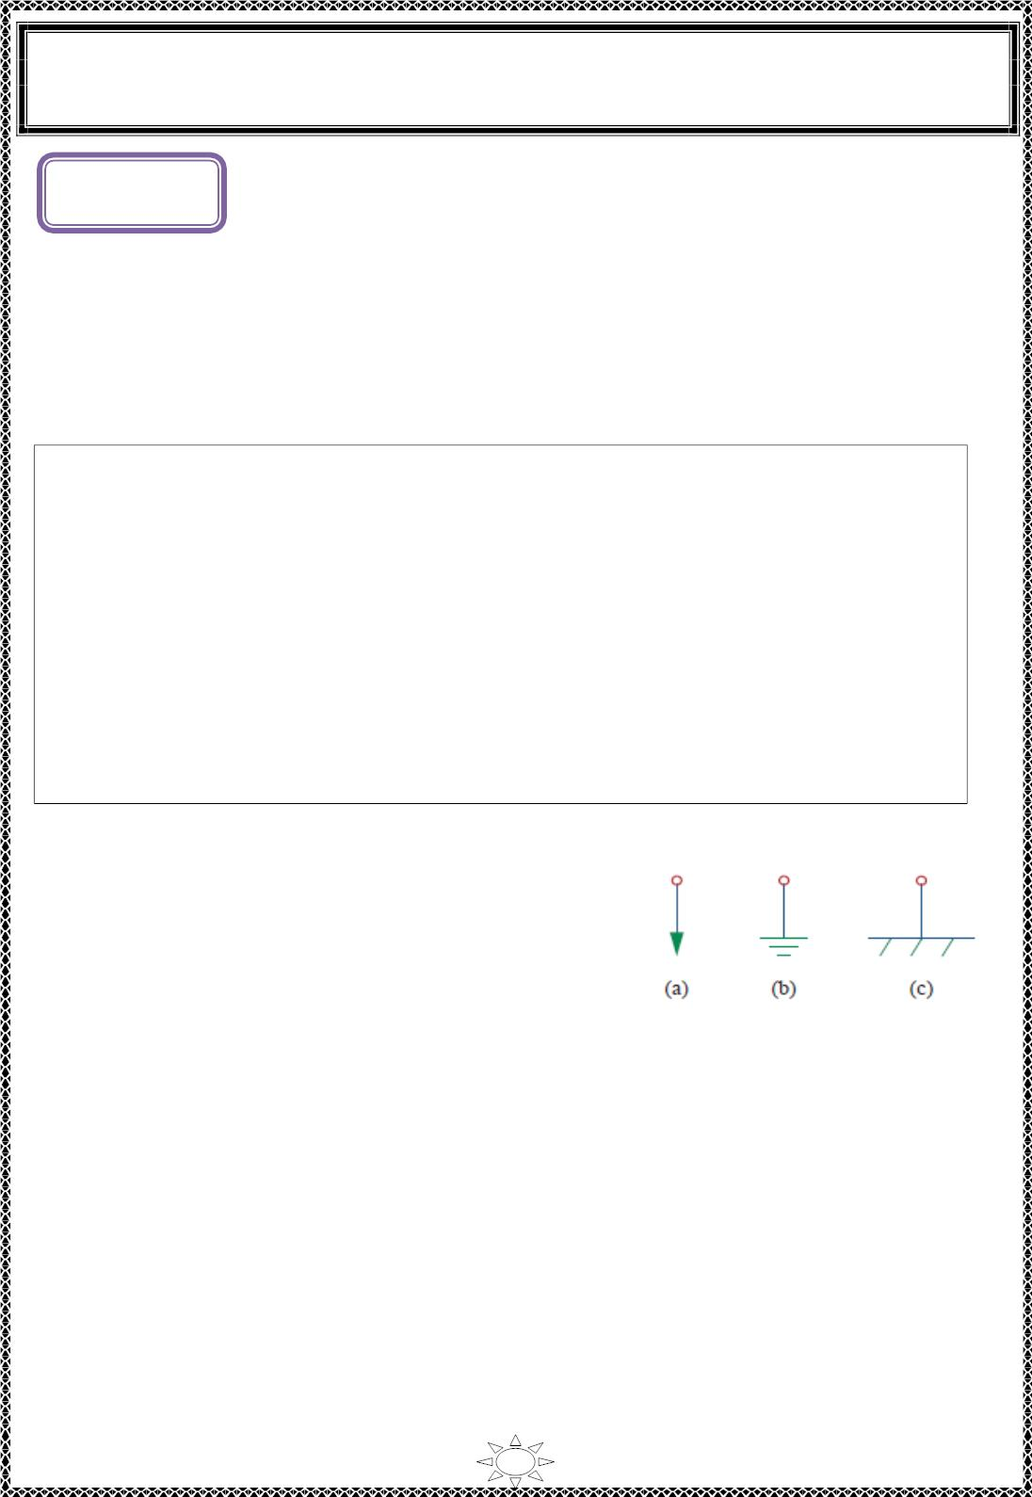
University of Diyala
Engineering College
Electronic Department
Electrical Engineering Fundamentals
1st Class
Asst., Lecturer : Wisam N. AL-Obaidi
Year (2013-2014)
L ectur e (4)
Nodal Analysis
Nodal analysis provides a general procedure for analy z in g c irc uits using node voltages as
the c ircuit variables. Choosing node vo ltages instead of element voltages as c ircuit
var iab les is convenient and reduces the number of equations one must s olve
simultaneously.
Steps to Determine Node Voltages:
1) Select a node as the reference node (it's voltage equal zero). As s ign vo ltages v , v ,
1
2
…, v_{n-1} to the remaining n-1 nodes. The voltages are referenced with respect to the
reference node.
2) Apply KCL to each of the n-1 non reference nodes. Use Ohm‘s law to express the
branch currents in terms of node voltages.
Trail Version
Trail Version
Trail Version
Trail Version
Trail Version
Trail Version
Trail Version
Trail Version
Trail Version
Trail Version
Trail Version
Trail Version
Trail Version
3) Solve the resulting simultaneous equations to obtain the unknown node voltages.
The first step in nodal analysis is s elec t ing a node as
the reference or datum node. The reference node is
c o mmo nly c a lled the ground since it is assumed to
have zero potential. A reference node is indicated by
any of the three s ymbols in Figure (4.1).
Figure (4.1): Common s ymbols
for ind ic at ing a reference node
55

Slide 6
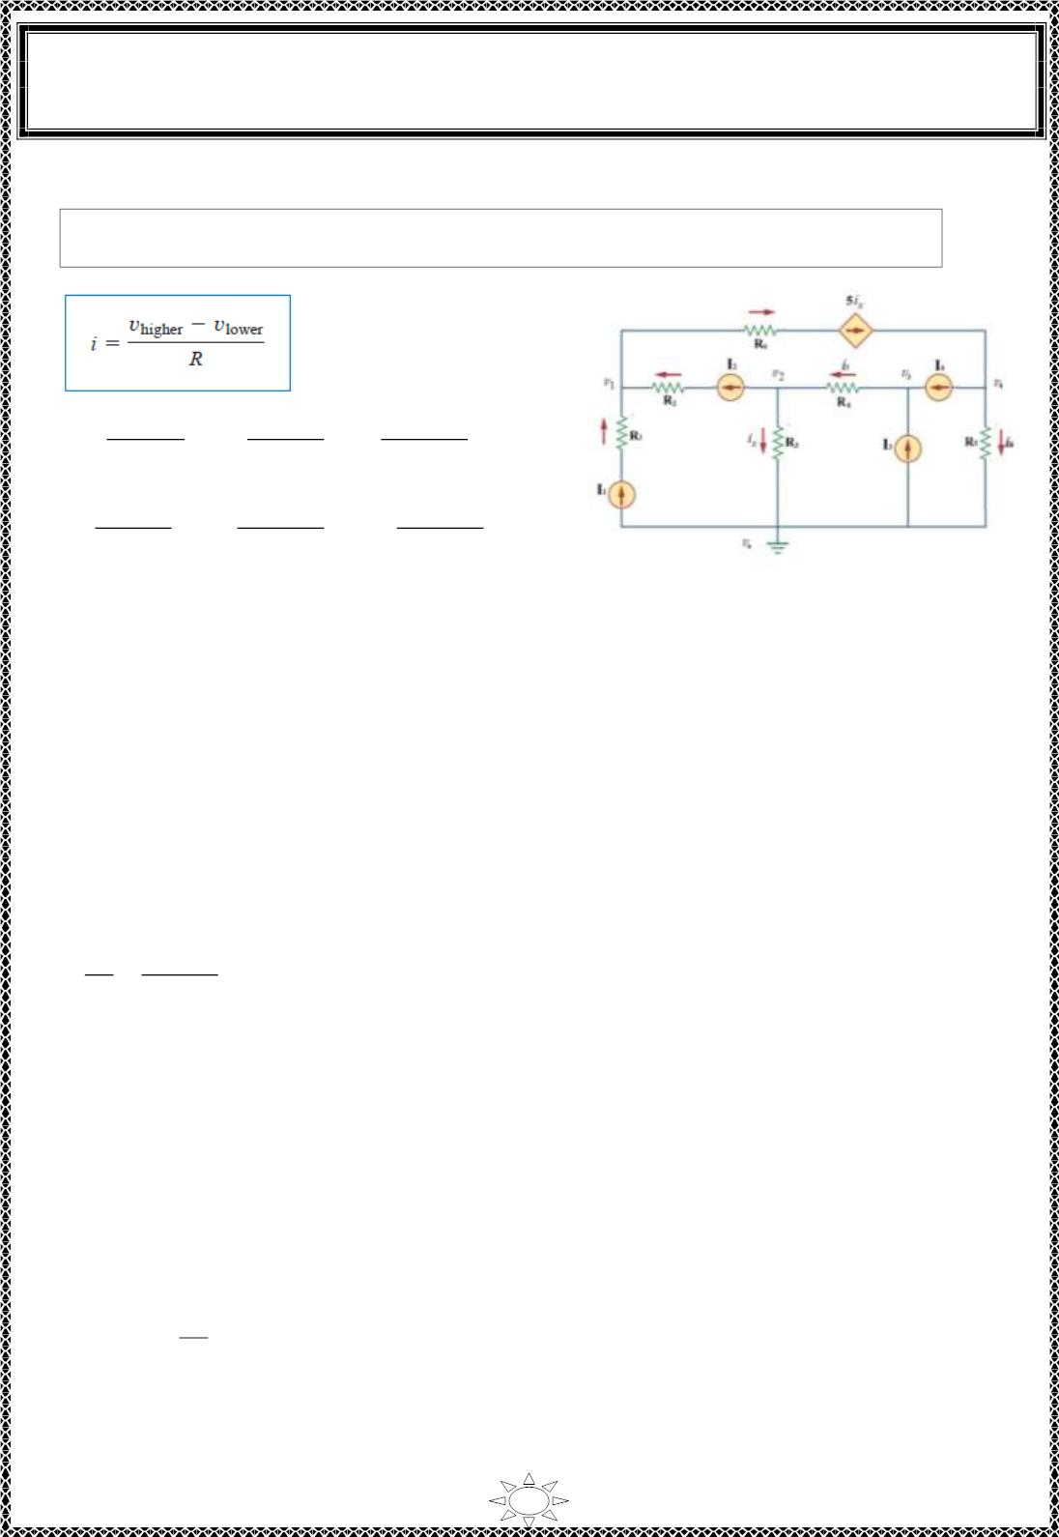
University of Diyala
Engineering College
Electronic Department
Electrical Engineering Fundamentals
1st Class
Asst., Lecturer : Wisam N. AL-Obaidi
Year (2013-2014)
1- Nodal Analysis with Current Sources
Note: Current f lows from a higher potential to a lower potential in a res istor.
∴ I₁ =
푣_{표} − 푣₁
푅₁
, I₂ =
푣₂− 푣₁
푅₂
, i_{x} =
푣₂ −푣_{표}
푅₃
,
i₅ =
푣₃ − 푣₂
푅₄
, i₆ =
푣₄ −푣_{표}
푅₅
, 5i_{x} =
푣₁ −푣₄
푅₆
Where V_{o} = 0
Figure (4.2)
For node (1):
Trail Version
Trail Version
Trail Version
Trail Version
Trail Version
Trail Version
Trail Version
Trail Version
Trail Version
Trail Version
Trail Version
Trail Version
Trail Version
Apply KCL, 5i – I – I =0
x
1
2
^{I}1^{+ I}
∴
i =
2
…(1)
…(2)
x
5
For node (2):
Apply KCL, I + i – i =0
2
x
5
I₂ +
푣₂ 푣₃− 푣₂
푅₃
–
푅₄
=0
For node (3):
Apply KCL, i – I – I =0
5
3
4
∴
i = I + I
4
…(3)
…(4)
5
3
For node (4):
Apply KCL, i + I – 5i =0
6
4
x
∴
푣₄
푅₅
+ I – 5i =0
4 x
Solving equations (1), (2), (3), and (4) to find the nodes voltages (푣 ,푣 ,푣 , 푎푛푑 푣 ) and
hence f ind the currents in the circuit (i , i , and i ).
1
2
3
4
x
5
6
56

Slide 7
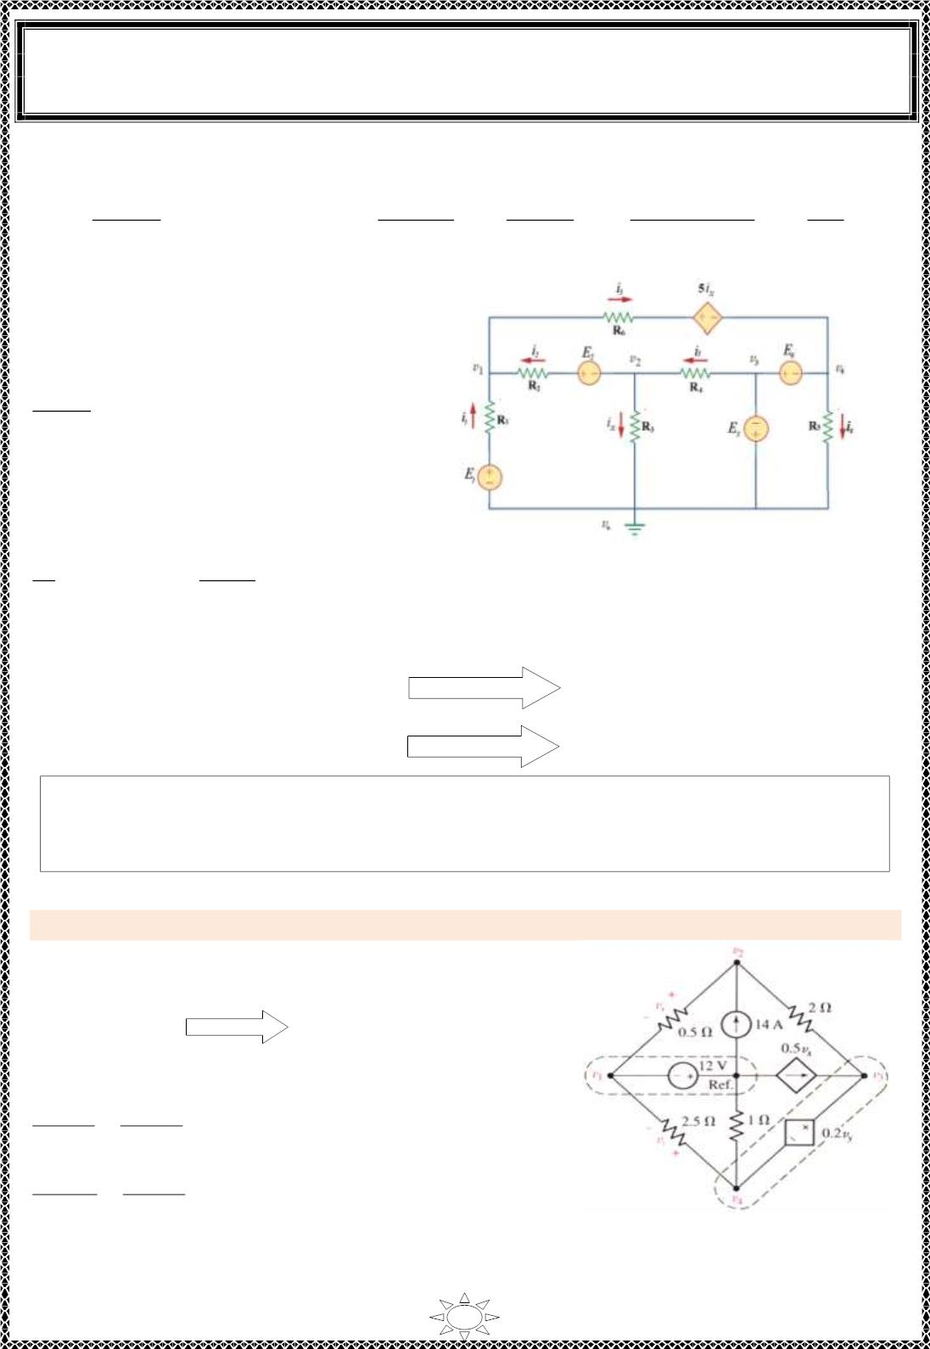
University of Diyala
Engineering College
Electronic Department
Electrical Engineering Fundamentals
1st Class
Asst., Lecturer : Wisam N. AL-Obaidi
Year (2013-2014)
2- Nodal Analysis with Voltage Sources
퐸₁− 푣₁
푅₁
푣 + 퐸 − 푣
푣₂ −푣_{표}
푅₃
푣₃− 푣₂
푅₄
푣 − 5ꢀ −푣
푣₄
푅₅
2
2
1
1
푥
4
∴ i₁ =
, i₂ =
푅₂
, i_{x} =
, i₅ =
, i₃ =
푅₆
, i₄ =
For node (1):
Apply KCL, – i – i + i =0
1
2
5
푣_{1− 퐸1} 푣₁ −퐸
푣
푣₁ −5ꢀ_{푥−}푣₄
푅₁
+
2− 2
+
=0
푅₂
푅₆
For node (2):
Apply KCL, i + i – i = 0
x
2
5
푣₂ 푣₂ +퐸
푣
푣₂ −푣₃
푅₄
푅₃
+
2− 1
+
= 0
Figure (4.3)
푅₂
Trail Version
Trail Version
Trail Version
Trail Version
Trail Version
Trail Version
Trail Version
Trail Version
Trail Version
Trail Version
Trail Version
Trail Version
Trail Version
For supernode (3) & (4) :
V + E =0,
∴ V₃ = E₃
3
3
V – E – V = 0 (Super node)
∴ V = E + V
3 4 4
3
4
4
A supernode is formed by enclos ing a (dependent or independent) vo ltage source
connected between two non reference nodes and any elements connected in parallel
with it.
Example 1: Determine the nod to reference voltages of the circuit shown in Figure (4.4).
Solution:
For node 1:
v₁+12 = 0
∴ v₁ = − 12 V
For node (2):
푣₂−푣₁ 푣₂−푣₃
−14 = 0
0.5
+
2
푣₂+12 푣₂−푣₃
0.5
+
2
= 14
…(1)
v = v – v
1
Figure (4.4 )
x
2
57

Slide 8
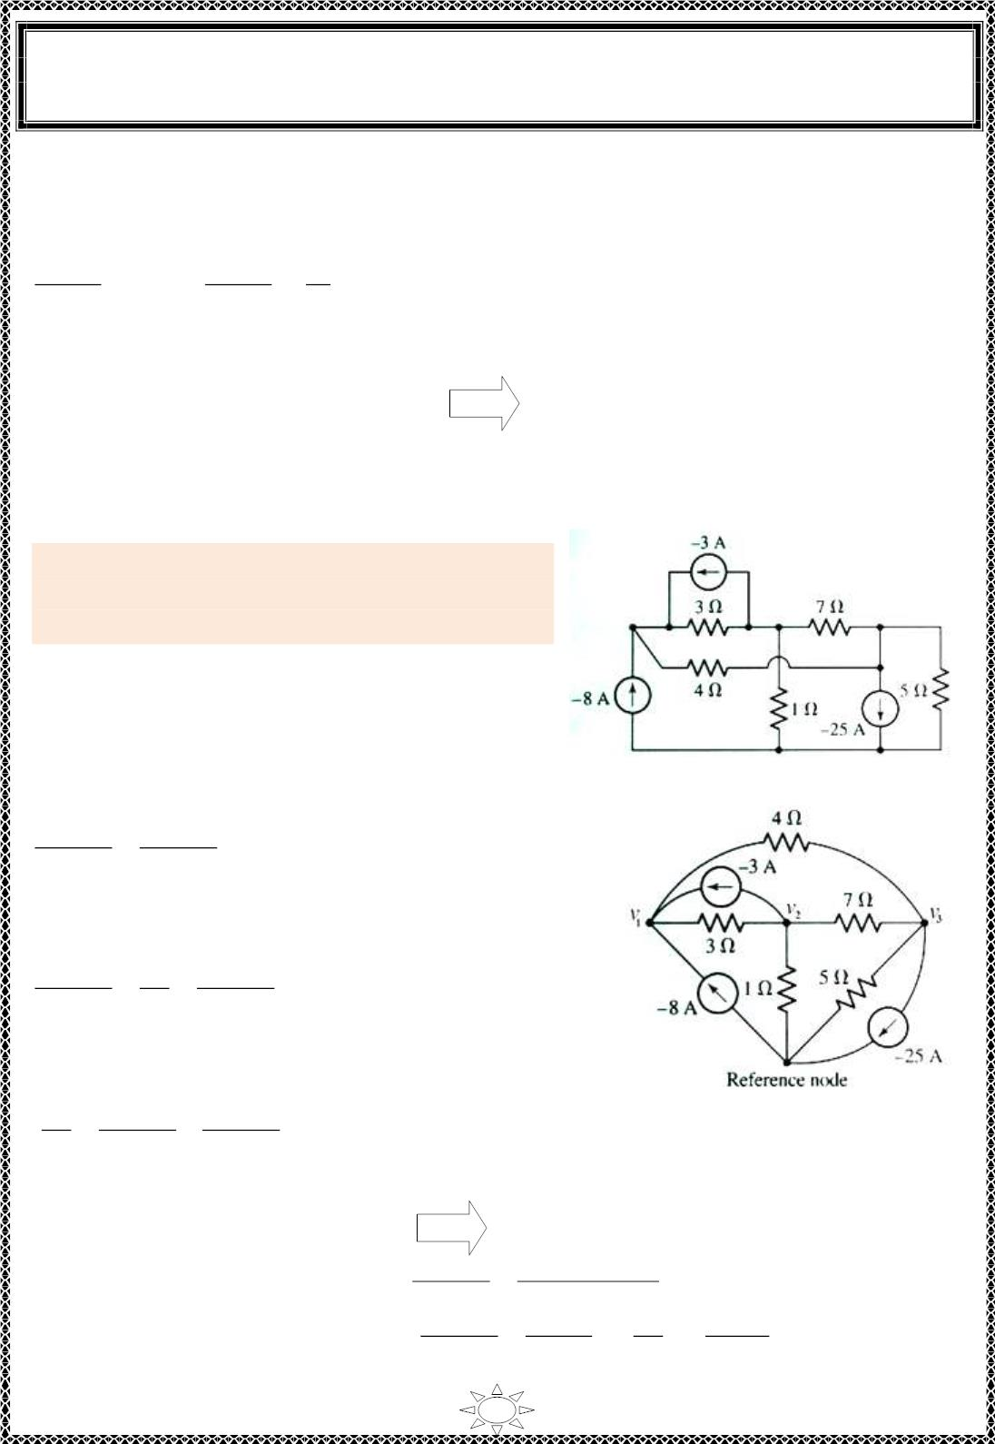
University of Diyala
Engineering College
Electronic Department
Electrical Engineering Fundamentals
1st Class
Asst., Lecturer : Wisam N. AL-Obaidi
Year (2013-2014)
For super node (3) & (4):
v – 0.2v – v = 0
…(2)
3
y
4
푣₃−푣₂
– 0.5v_{x} +
푣₄−푣₁
2.5
푣₄
1
2
+
= 0
…(3)
v – v – v =0
…(4)
4
y
1
solving equations (1), (2), (3), and (4),
v = –12 V, v = –4 V, v = 0 V, v = –2 V
1
2
3
4
Example 2: Determine the current in (7Ω) & (1Ω)
resistors using nodal analysis of the circuit shown
in Figure (4.5 ).
Solution:
Trail Version
Trail Version
Trail Version
Trail Version
Trail Version
Trail Version
Trail Version
Trail Version
Trail Version
Trail Version
Trail Version
Trail Version
Trail Version
Redraw the circuit and indicate the nodes and
reference node as s hown in Figure (4.6).
Figure (4.5)
At node (1):
푣 − 푣
푣₁ − 푣₃
1
2
3
+
4
+ 8 + 3 = 0
∴ 0.5833 v – 0.3333 v – 0.25 v = –11
…(1)
…(2)
…(3)
1
2
3
At node (2):
푣₂ − 푣₃
푣 − 푣
푣
2
2
1
3
+
+
– 3 = 0
1
7
∴ – 0.3333 v + 1.4762 v – 0.1429 v = 3
1
2
3
At node (3):
푣₃ − 푣₁
푣
푣 − 푣
3
3
2
Figure (4.6)
5
+
7
+
4
– 25 = 0
∴ – 0.25 v – 0.1429 v + 0.5929 v = 25
1
2
3
Solving Equ.s (1), (2) & (3) we get,
v = 5.412 V, v = 7.736 V & v = 46.32 V
^{푣}3 ^{− 푣}
1
2
3
Now,
Current in (7Ω) is, I_{7Ω} =
Current in (1Ω) is, I_{1Ω} =
2
46 .32 – 7.736
=
7
=
7
5.512 A
7.736
1
푣 − 푣
^{푣}2 ⁻ ⁰
^{푣}2
1
2
표
=
=
=
=
7.736 A
1
1
58

Slide 9
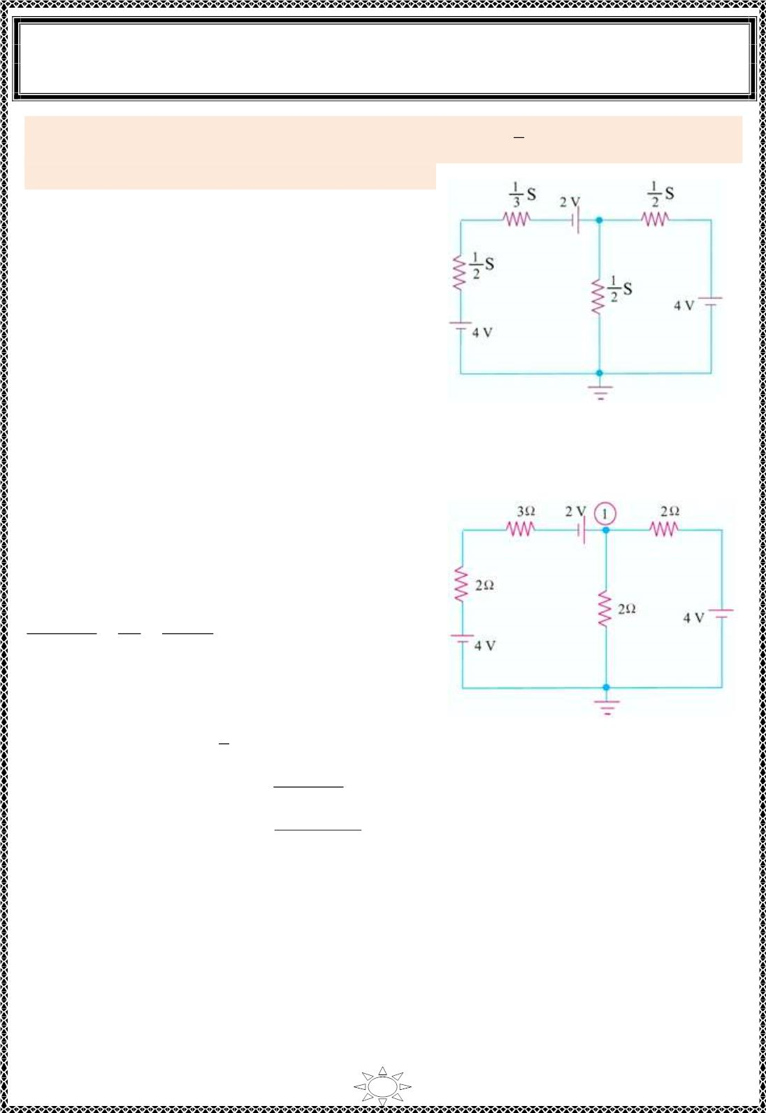
University of Diyala
Engineering College
Electronic Department
Electrical Engineering Fundamentals
1st Class
Asst., Lecturer : Wisam N. AL-Obaidi
Year (2013-2014)
1
Example 3: Using nodal analys is, determine the current in ( S) of the c irc uit shown in
Figure (4.7).
Solution:
3
Note that in this circuit a conductance values were
given, so we convert it to a resistances and redraw
the circuit as shown in Figure (4.8).
Figure (4.7)
Trail Version
Trail Version
Trail Version
Trail Version
Trail Version
Trail Version
Trail Version
Trail Version
Trail Version
Trail Version
Trail Version
Trail Version
Trail Version
At node (1):
푣₁ −2−4 푣₁
푣₁ − 4
3+2
+
+
= 0
2
2
∴ v₁ = 2.67 V
1
Figure (4.8)
So the current through ( S) = current through (3Ω)
3
푣₁ −2−4
=
3+2
2.67 −2−4
=
3+2
= − 0.666 A
59

Slide 10
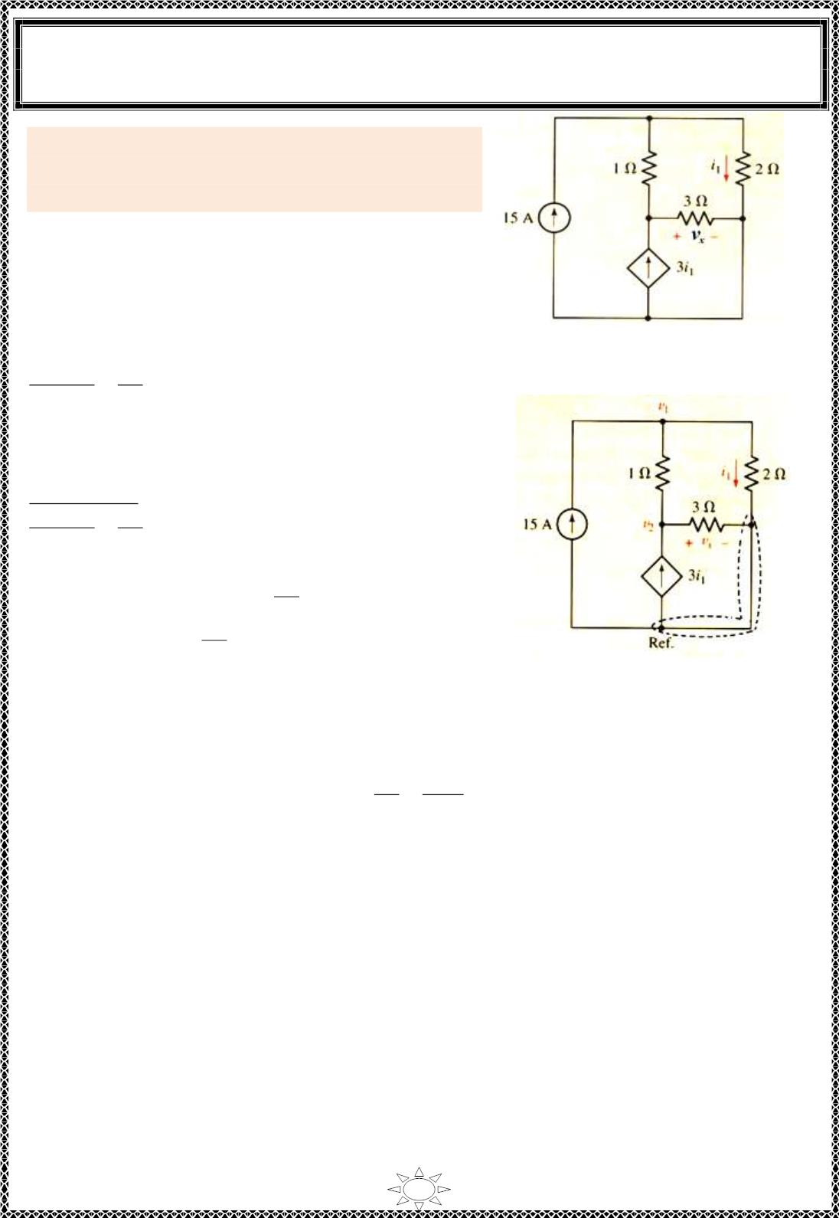
University of Diyala
Engineering College
Electronic Department
Electrical Engineering Fundamentals
1st Class
Asst., Lecturer : Wisam N. AL-Obaidi
Year (2013-2014)
Example 4: Determine the power s up p lied by the
dependent source of the Figure (4.9) using nodal
analys is.
Solution:
Redraw the circuit and indicate the nodes and
reference node as s hown in Figure (4.10).
At node (1):
Figure (4.9)
푣 − 푣
푣
1
1
2
1
+
– 15 = 0
2
∴ 1.5 v – v = 15
…(1)
1
2
At node (2):
푣 − 푣
푣
2
3
2
1
}× 3
1
+
– 3i₁ = 0
Trail Version
Trail Version
Trail Version
Trail Version
Trail Version
Trail Version
Trail Version
Trail Version
Trail Version
Trail Version
Trail Version
Trail Version
Trail Version
3 v – 3 v + v – 9i = 0
2
1
2
1
푣₁
2
– 3 v + 4v – 9i = 0, i =
1
2
1
푣₁
2
1
∴ – 3 v + 4v – 9( ) = 0
1
2
Figure (4.10)
∴ – 7.5 v + 4v = 0
…(2)
1
2
Solve Equ.s (1) & (2) we get,
v = – 40 V & v = – 75 V
&
^{푣}1
2
– 40
=
– 20 A
1
2
i₁ =
=
2
Now the power supplied by the dependent source is,
P = IV = (3i ) v = (3×(-20)) × (– 75) = 4500 W = 4.5 kW
1
2
60

